Slide 1
Cotiviti Hackathon | Report + POC
AI-Powered Healthcare Content Intelligence Platform
Policy PDFs
↓
Transforming Healthcare Policies into Intelligent Decision Support Systems
AI Intelligence Layer
↓
Decision Support
Working POC covers classification, summarization, RAG, rule extraction, feature extraction, claim decision, explainability, and evaluation.
Nihil Rengasamy
University at Albany
June 2026
Cotiviti Hackathon Assessment
Notes:
This deck summarizes both my written report and my working proof of concept for Cotiviti.
The topic is AI-powered healthcare content intelligence, which focuses on turning policy-heavy healthcare documents into structured, explainable decision support.
I will start with the business problem, then show the proposed solution, the system architecture, the demonstration workflow, and the business value for Cotiviti.
The key message is that this is not just an AI demo. It is a practical, human-in-the-loop platform concept that fits payment integrity workflows.

Slide 2
Problem Statement
Healthcare policy review is manual, fragmented, and difficult to operationalize at scale.
Manual review
Current challenge flow
Analysts read long PDFs and translate policy language into action.
Policy PDF
Manual analyst review
→
Frequent changes
Coverage criteria and coding rules change faster than teams can operationalize.
↓
Delayed rule usage
Interpretation lag
Slow implementation
←
Policy updates take time to become usable rules and reference logic.
Payment leakage risk
Core implication for Cotiviti
Misread or delayed policy interpretation can affect payment integrity.
• Policy understanding stays person-dependent
• Scaling quality requires more effort, not more intelligence
• Decision support arrives too late in the workflow
Cotiviti Hackathon Assessment | AI-Powered Healthcare Content Intelligence Platform
02
Notes:
The problem starts with the nature of healthcare content itself. Policy documents are long, complex, and frequently updated.
Today, much of the interpretation work still depends on manual reading, tribal knowledge, and delayed translation into operational logic.
That creates risk in payment accuracy, workflow speed, and compliance. It also makes policy execution inconsistent across teams.
This sets up the need for a simple but credible AI proof of concept that shows how documents can be transformed into usable intelligence.

Slide 3
Project Objective
Move from document-heavy manual review to an AI-assisted, human-validated operating model.
Current process
AI-powered process
Upload & classify
Read PDF
↓
↓
Summarize & compare
Automation opportunities
Interpret policy
↓
• Reduce repetitive document reading
• Standardize interpretation
• Surface explainable recommendations
→
Ask grounded questions
↓
Translate to rules
↓
Extract rules & features
↓
↓
Review exceptions
Support decisions
Cotiviti Hackathon Assessment | AI-Powered Healthcare Content Intelligence Platform
03
Notes:
The objective of this project is not to replace analysts. It is to improve how analysts work.
On the left is the current process, which is document-heavy and slow to scale. On the right is the target process, where AI accelerates ingestion, search, summarization, extraction, and decision support.
The real value comes from shifting effort away from basic reading and toward higher-value review and judgment.
That transition is what the proof of concept was designed to demonstrate end to end.

Slide 4
Why This Matters for Cotiviti
The use case aligns directly with payment integrity, policy interpretation, and explainable operational decision support.
Reduced manual effort
Faster policy updates
Improved payment integrity
Less time spent reading and re-reading long policy PDFs.
Shorter path from policy revision to usable decision support.
More consistent interpretation of coverage and coding logic.
Lower operating cost
Explainable recommendations
Reusable intelligence layer
Better analyst leverage without adding workflow complexity.
Human reviewers can see why a recommendation was made.
Policies become a searchable, structured knowledge asset.
Cotiviti Hackathon Assessment | AI-Powered Healthcare Content Intelligence Platform
04
Notes:
This matters for Cotiviti because the business problem is not abstract. It sits directly inside payment integrity and policy-driven operational work.
The platform can reduce manual effort, speed up policy interpretation, and improve consistency without removing the analyst from the loop.
It also creates explainability and reuse, which are important differentiators in regulated healthcare environments.
This slide connects the technical build to clear business outcomes before we go deeper into architecture.

Slide 5
Overall System Architecture
End-to-end flow from healthcare documents to explainable decision support.
Input layer
Ingestion layer
Knowledge layer
Decision layer
Trust layer
Healthcare Documents
PDF Loader
Document Classifier
Summarizer
Version Comparison
Embeddings
FAISS
→
→
→
→
→
→
↓
RAG
Rule Extraction
Feature Extraction
Rule Engine
ML Model
Claim Decision
Explainability
Evaluation Dashboard
→
→
→
→
→
→
→
Architecture principle
The platform converts unstructured healthcare documents into grounded answers, reusable rules, structured features, and explainable recommendations. The design intentionally keeps humans in the loop for high-stakes interpretation and decision review.
Cotiviti Hackathon Assessment | AI-Powered Healthcare Content Intelligence Platform
05
Notes:
This is the full system architecture for the proof of concept.
The flow begins with multiple healthcare document types and then moves through ingestion, classification, summarization, comparison, embeddings, retrieval, extraction, decision support, and explainability.
The architecture is modular by design, which means each stage can be evaluated separately while still contributing to an end-to-end workflow.
That modularity is useful for Cotiviti because it supports phased adoption rather than requiring one large system rollout.

Slide 6
Technology Stack
Grouped by business purpose rather than listed as a flat tool inventory.
Programming
AI & LLM
Retrieval & NLP
Python 3.11+
Modular OOP structure
Typed production-style modules
Groq / GPT-compatible summarization
Prompt-managed extraction
Policy Q&A patterns
LangChain
sentence-transformers
RAG orchestration
ML & Analytics
Application Layer
Storage & Parsing
Scikit-learn
Pandas
NumPy
Streamlit multipage UI
Session state workflow
Downloadable outputs
PyMuPDF
FAISS
JSON / local artifacts
Cotiviti Hackathon Assessment | AI-Powered Healthcare Content Intelligence Platform
06
Notes:
I grouped the stack by purpose so the audience can see why each technology exists.
Python and Streamlit support rapid application development. LangChain, embeddings, and FAISS support retrieval and search. Scikit-learn supports lightweight predictive signals. PyMuPDF and structured JSON outputs support document parsing and downstream reuse.
The stack is intentionally practical for a hackathon-style proof of concept. It demonstrates capability without overcomplicating deployment.
Next, I move from technology choice into the live workflow of the POC.

Slide 7
Proof of Concept Workflow
Simple end-to-end demonstrator showing the main functions of the platform.
Upload
Classify
Summarize
Compare
Chat
Extract Rules
→
→
→
→
→
↓
Extract Features
Rule Engine
ML
Decision
Explanation
Evaluation
→
→
→
→
→
→
Hackathon design principle: keep the workflow simple, visible, and demonstrable rather than over-optimizing for full production complexity.
Cotiviti Hackathon Assessment | AI-Powered Healthcare Content Intelligence Platform
07
Notes:
This is the live workflow that the proof of concept demonstrates.
The user journey starts with document upload and continues through classification, summarization, version comparison, policy chat, rule extraction, feature extraction, rule execution, ML support, claim decisioning, explainability, and evaluation.
The important point is that the POC proves the flow across modules, not just isolated technical features.
That makes it a strong hackathon submission because it shows hands-on engineering and general capability without overcomplicating the demonstration.

Slide 8
Core AI Modules
All fifteen modules are grouped into business-facing capabilities for the platform.
Ingestion and intelligence modules
Decision, trust, and platform modules
Module
Purpose
Technology
Business Benefit
Module
Purpose
Technology
Business Benefit
PDF Loader
Parse policy pages
PyMuPDF
Creates analyzable input
Rule Extraction
Convert policy to rules
LLM + schema
Draft executable logic
Document Classifier
Identify document type
Rules + LLM
Routes correct workflow
Feature Extraction
Create structured features
LLM + regex
Model-ready policy data
Summarizer
Create structured summary
LLM
Speeds analyst review
Rule Engine
Evaluate rules on features
Deterministic Python
Transparent decision checks
Version Comparison
Compare old vs new policies
Diff + LLM
Highlights meaningful change
ML Model
Generate predictive signals
Scikit-learn
Adds probabilistic support
Embeddings
Vectorize text chunks
Sentence Transformers
Enables semantic retrieval
Claim Decision
Combine rule + ML signals
Hybrid logic
Final recommendation
Vector Store
Store/search vectors
FAISS
Fast similarity search
Explainability
Explain why decision happened
Traceable reasoning
Builds user trust
RAG
Answer policy questions
Retriever + LLM
Grounded policy Q&A
Evaluation
Score system quality
Rule-based QA
Monitors groundedness
Prompt Manager
Centralize prompts
Template control
Consistent prompt quality
Cotiviti Hackathon Assessment | AI-Powered Healthcare Content Intelligence Platform
08
Notes:
This slide summarizes the full module inventory across the project.
The left table covers ingestion, understanding, retrieval, and prompt governance. The right table covers extraction, decision logic, explainability, and evaluation.
I framed each module in terms of business purpose and benefit so the audience can see how technical components map to operational value.
This also reinforces that the platform is modular and extendable rather than being a one-off demo script.

Slide 9
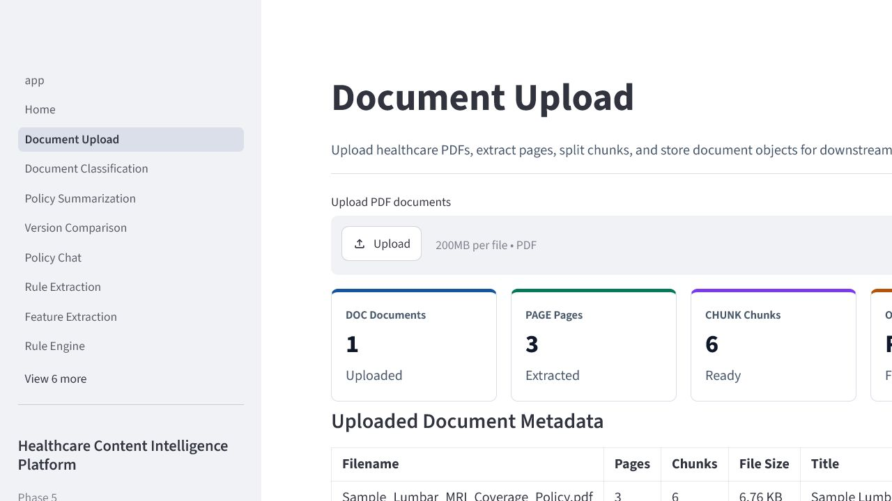
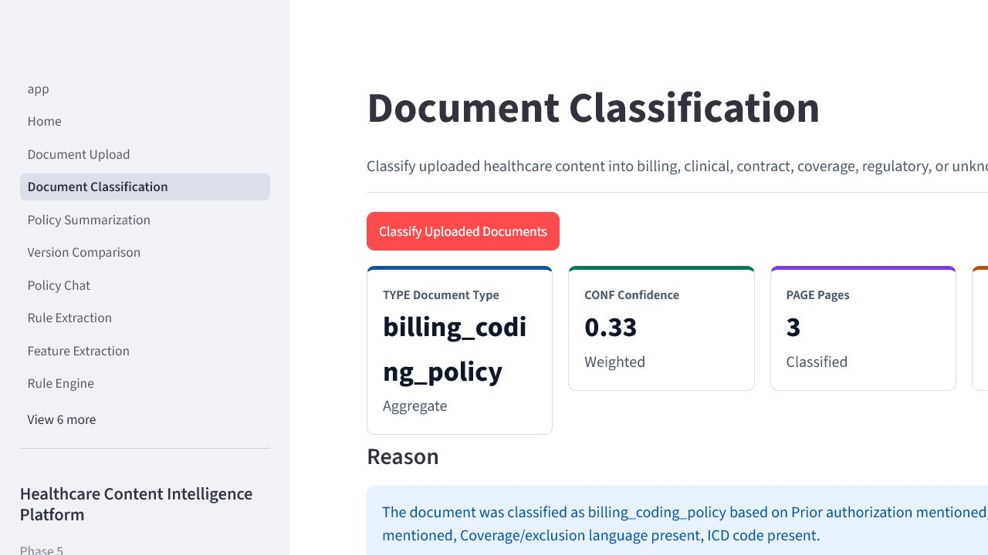
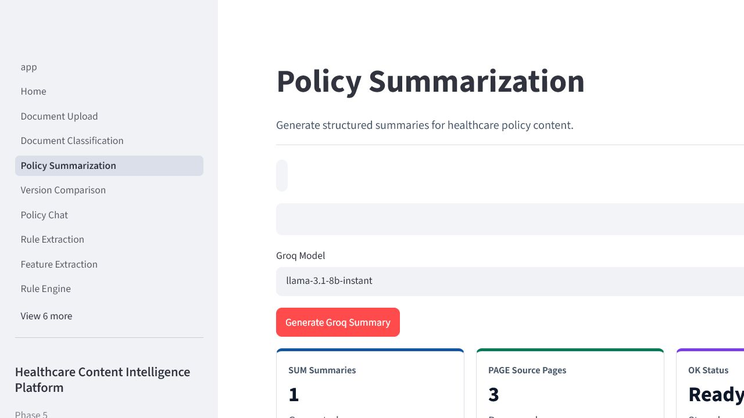
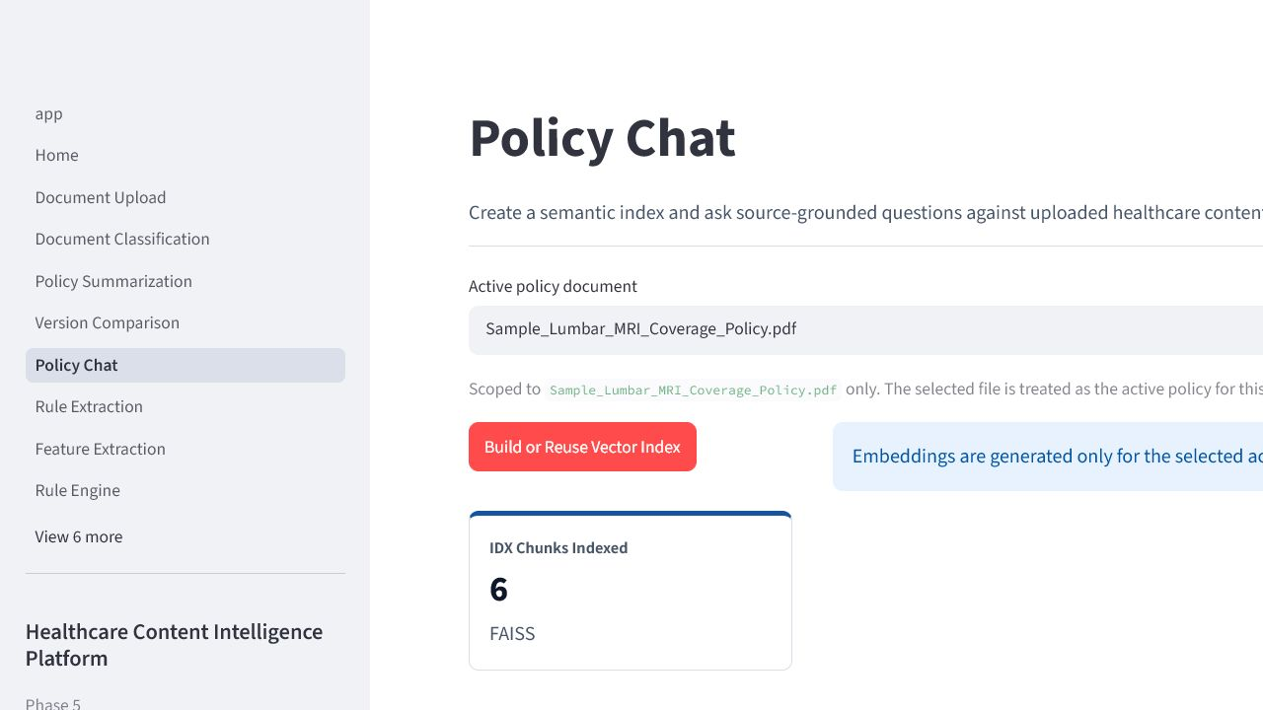
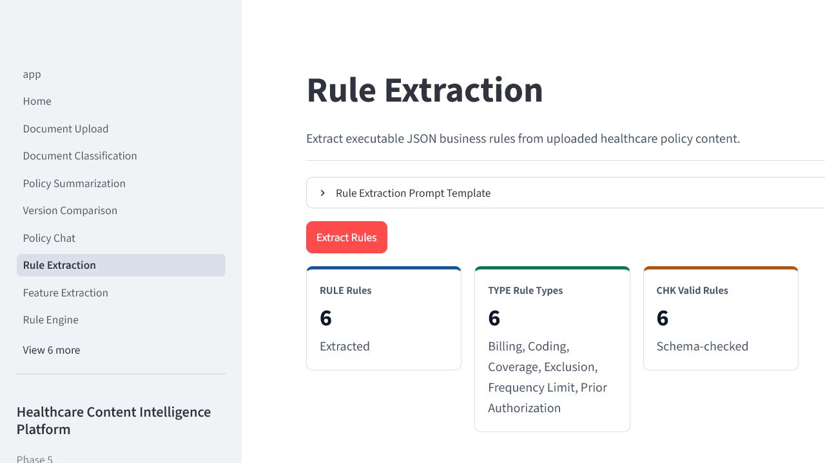
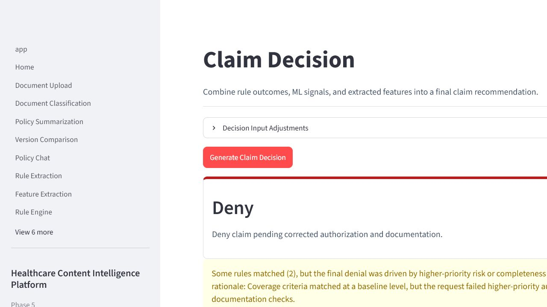
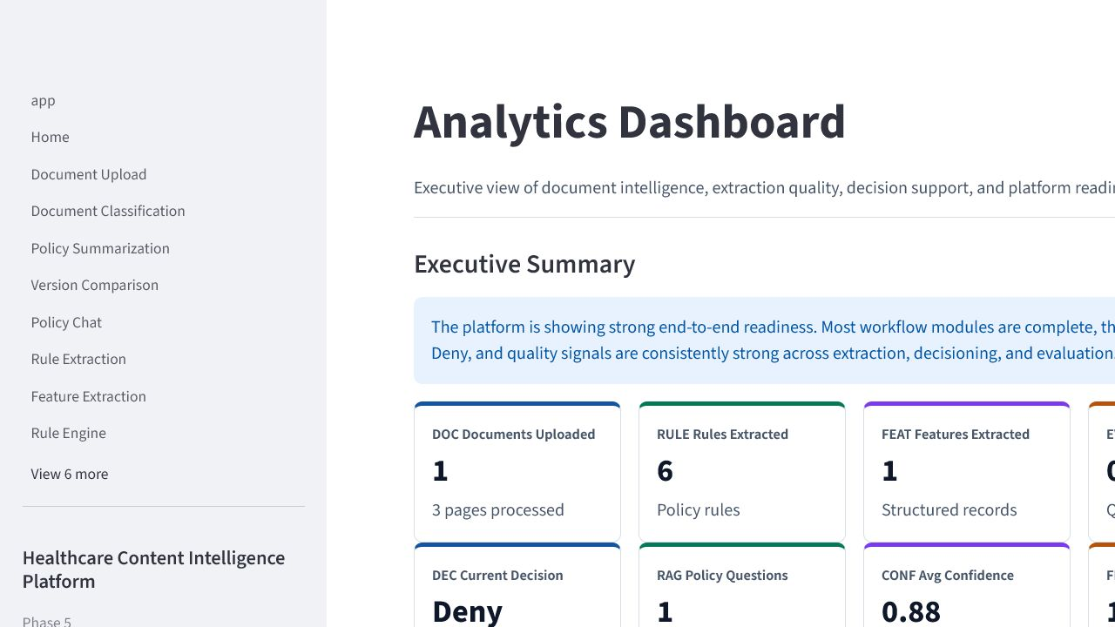
POC Demonstration
Suggested storyboard for the live demo and screenshot evidence.
Cotiviti Hackathon Assessment | AI-Powered Healthcare Content Intelligence Platform
09
Notes:
This slide is designed to support the demo portion of the presentation.
Each placeholder can be replaced with a clean screenshot from the working Streamlit application. The most important screens are upload, classification, summarization, policy chat, rule extraction, claim decisioning, and analytics.
During the live presentation, I would walk through the workflow in the same order shown earlier so the story remains easy to follow.
This keeps the POC concrete and visually grounded for both technical and non-technical reviewers.

Slide 10
Business Value
The proof of concept is designed to create operational leverage, not just technical novelty.
Value infographic
Reduced manual review
Faster policy updates
Payment
Integrity
Improved consistency
Higher payment integrity
Scalable AI platform
Human-in-the-loop validation
Cotiviti Hackathon Assessment | AI-Powered Healthcare Content Intelligence Platform
10
Notes:
The business value is centered on better payment integrity supported by faster and more consistent policy intelligence.
Instead of presenting aggressive ROI claims, this slide stays grounded in realistic value areas: reduced manual review, faster policy updates, better consistency, scalable platform design, and explainable human validation.
That framing is important because this is a hackathon proof of concept. The goal is to demonstrate believable capability and strategic relevance, not to overclaim production results.
Next, I address how the platform handles responsible AI concerns.

Slide 11
Responsible AI and Governance
High-stakes healthcare workflows require grounded answers, transparent logic, and visible controls.
Hallucination risk
→
RAG grounds answers in retrieved policy text and source citations.
Policy ambiguity
→
Human reviewers validate summaries, rules, and decision recommendations.
Low-confidence outputs
→
Confidence scoring and evaluation signals surface uncertainty.
Opaque recommendations
→
Explainability module shows reasons, evidence, and next actions.
Compliance exposure
→
Audit trails, structured outputs, and HIPAA-aware handling support review.
Cotiviti Hackathon Assessment | AI-Powered Healthcare Content Intelligence Platform
11
Notes:
Responsible AI is essential for this use case because healthcare content directly influences high-stakes operational decisions.
The main risks are hallucination, ambiguity, low confidence, lack of transparency, and compliance exposure.
The platform addresses those risks through grounded retrieval, confidence signals, structured outputs, explainability, evaluation, and human-in-the-loop review.
This is also why the recommendation is to position the system as decision support rather than as a fully autonomous adjudication engine.

Slide 12
Future Enhancements
A phased roadmap keeps the strategy practical while expanding the intelligence layer over time.
Now
Next
Later
• Imaging policy rollout
• Prior authorization workflows
• Human-reviewed rule authoring
• FHIR integration
• Knowledge graph layer
• Cloud-hosted collaboration
• Graph RAG
• Multi-agent orchestration
• Real-time monitoring and feedback learning
→
→
Strategic posture
Start with a narrow, high-value analyst copilot and expand only after the trust, retrieval quality, and rule-feature alignment are strong.
Cotiviti Hackathon Assessment | AI-Powered Healthcare Content Intelligence Platform
12
Notes:
This roadmap reflects the recommendation from the written report: start narrow, prove value, and then expand.
The first phase focuses on use cases where policy interpretation matters immediately and where human review can stay closely involved.
The next and later phases show how the platform could grow into richer interoperability, knowledge graph, and monitoring capabilities without changing the core business logic.
That approach balances ambition with realism, which is important for both Cotiviti and the hackathon context.

Slide 13
Conclusion
The project demonstrates a practical path from policy documents to explainable decision support.
Problem
Solution
Healthcare policy review is complex, slow, and difficult to operationalize consistently.
A modular AI platform converts documents into grounded summaries, answers, rules, features, and recommendations.
POC proof
Strategic value
The working Streamlit demonstrator shows the full end-to-end flow across multiple AI modules.
Cotiviti can explore this as a human-in-the-loop capability aligned with payment integrity workflows.
AI + Human Expertise = Better Healthcare Payment Integrity
Detailed references are provided in the written report bibliography.
Cotiviti Hackathon Assessment | AI-Powered Healthcare Content Intelligence Platform
13
Notes:
To conclude, the core problem is real, the proposed solution is aligned to Cotiviti’s domain, and the proof of concept demonstrates the concept in a practical way.
The platform is intentionally modular, explainable, and human-in-the-loop. That is what makes it more believable as a strategic direction than a generic AI demo.
If Cotiviti wants to explore this area further, the best next step is a focused pilot around high-value policy use cases with clear evaluation criteria.
The final takeaway is simple: AI plus human expertise can create better healthcare payment integrity outcomes.

